Slide 1
Decision Tree

Slide 2
Introduction
A Decision tree is a flowchart like tree structure, where each internal node denotes a test on an attribute, each branch represents an outcome of the test, and each leaf node (terminal node) holds a class label.
Tree based learning algorithms are considered to be one of the best and mostly used supervised learning methods.
Tree based methods empower predictive models with high accuracy, stability and ease of interpretation.
Unlike linear models, they map non-linear relationships quite well.
They are adaptable at solving any kind of problem at hand (classification or regression).
Methods like decision trees, random forest, gradient boosting are being popularly used in all kinds of data science problems.

Slide 3
Assumptions while creating Decision Tree
Some of the assumptions we make while using Decision tree:
At the beginning, the whole training set is considered as the root.
Feature values are preferred to be categorical. If the values are continuous then they are discretized prior to building the model.
Records are distributed recursively on the basis of attribute values.
Order to placing attributes as root or internal node of the tree is done by using some statistical approach.

Slide 4
Common terms used with Decision trees:
Root Node: It represents entire population or sample and this further gets divided into two or more homogeneous sets.
Splitting: It is a process of dividing a node into two or more sub-nodes.
Decision Node: When a sub-node splits into further sub-nodes, then it is called decision node.
Leaf/ Terminal Node: Nodes do not split is called Leaf or Terminal node.
Pruning: When we remove sub-nodes of a decision node, this process is called pruning. You can say opposite process of splitting.
Branch / Sub-Tree: A sub section of entire tree is called branch or sub-tree.
Parent and Child Node: A node, which is divided into sub-nodes is called parent node of sub-nodes whereas sub-nodes are the child of parent node.

Slide 5
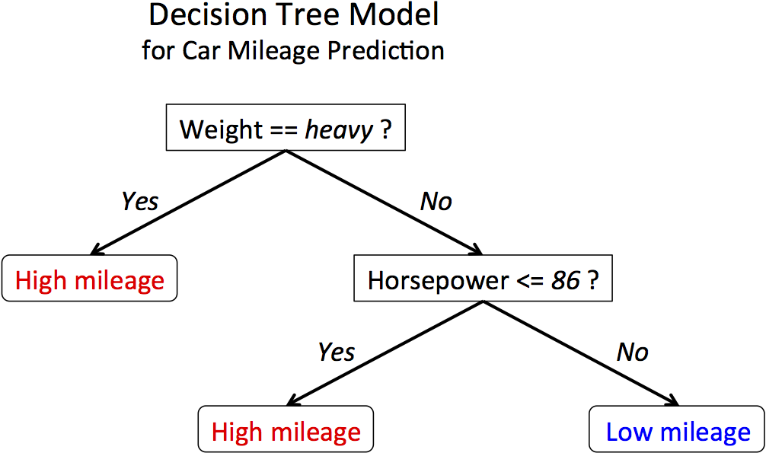
Sample Decision Tree

Slide 6
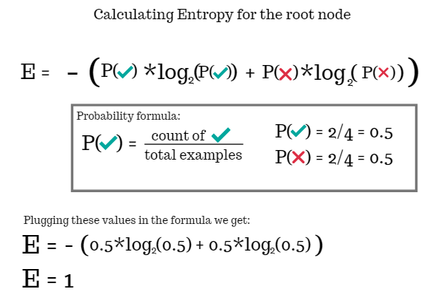
How a Decision Tree Works
Place the best attribute of the dataset at the root of the tree.
Split the training set into subsets. Subsets should be made in such a way that each subset contains data with the same value for an attribute.
Repeat step 1 and step 2 on each subset until you find leaf nodes in all the branches of the tree.

Slide 7
Hyper parameter Tuning
criterion{“gini”, “entropy”}, default=”gini”
The function to measure the quality of a split. Supported criteria are “gini” for the Gini impurity and “entropy” for the information gain.
splitter{“best”, “random”}, default=”best”
The strategy used to choose the split at each node. Supported strategies are “best” to choose the best split and “random”
to choose the best random split.
max_depth int, default=None
The maximum depth of the tree. If None, then nodes are expanded until all leaves are pure or until all leaves contain less
than min_samples_split samples.
min_samples_split int or float, default=2
The minimum number of samples required to split an internal node:
min_samples_leaf int or float, default=1
The minimum number of samples required to be at a leaf node. A split point at any depth will only be considered if it leaves
at least min_samples_leaf training samples in each of the left and right branches. This may have the effect of smoothing the model, especially in regression.

Slide 8
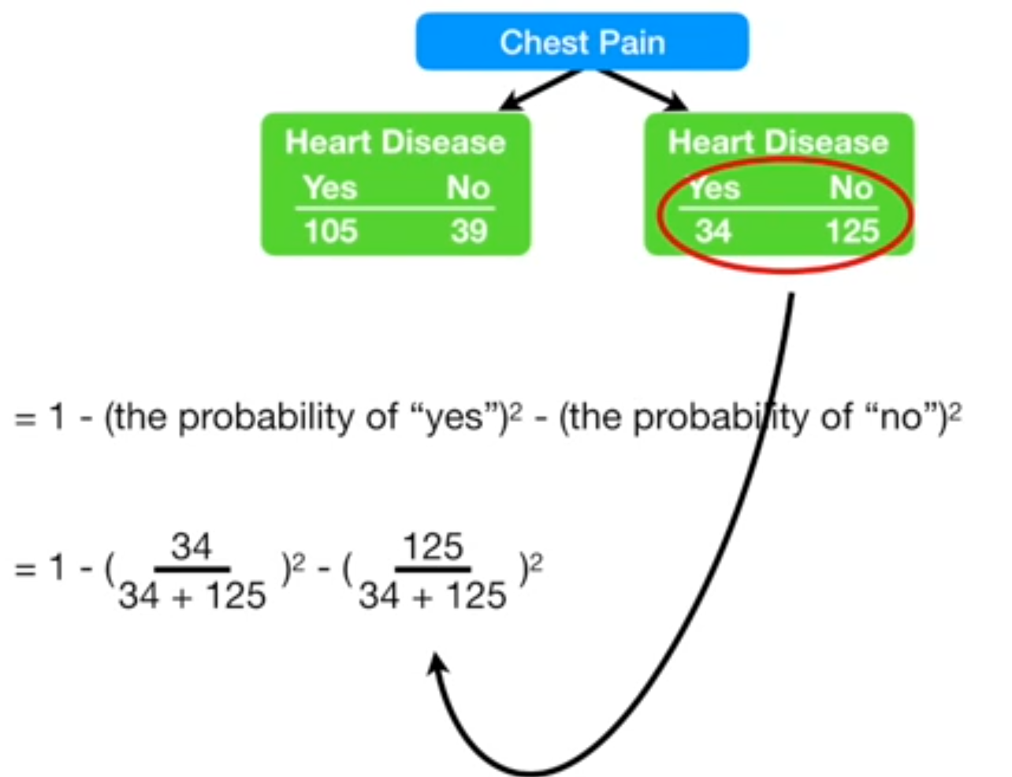
Hyper Parameter Tuning
max_features int, float or {“auto”, “sqrt”, “log2”}, default=None
The number of features to consider when looking for the best split:
max_leaf_nodes int, default=None
Grow a tree with max_leaf_nodes in best-first fashion. Best nodes are defined as relative reduction in impurity.
If None then unlimited number of leaf nodes.
min_impurity_decrease float, default=0.0
A node will be split if this split induces a decrease
of the impurity greater than or equal to this value.

Slide 9
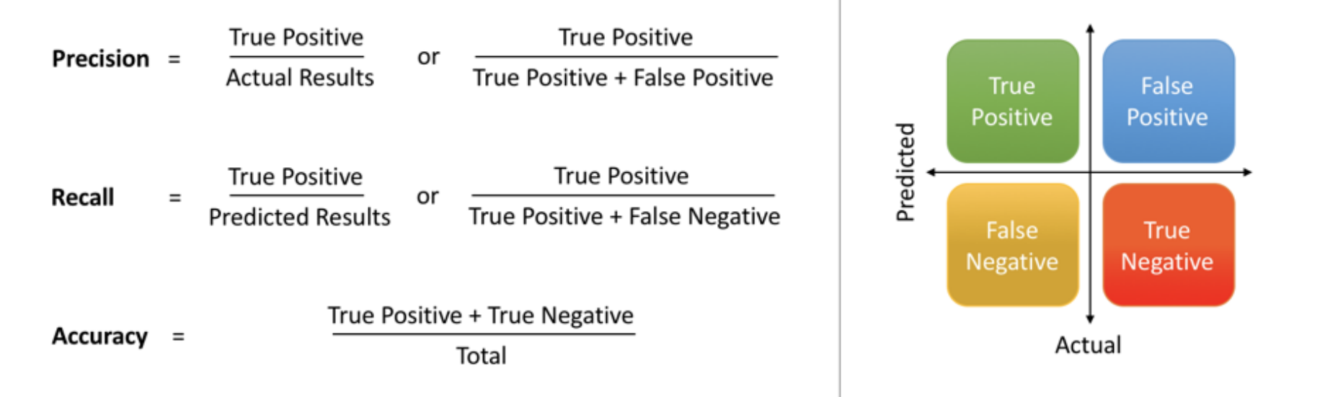
Model Evaluation Metrics
The various metrics used to evaluate
the results of the prediction are :
Accuracy
Precision
Recall
Area Under ROC Curve
MAPE/ MAD/ RMSE (For Regressors)

Slide 10
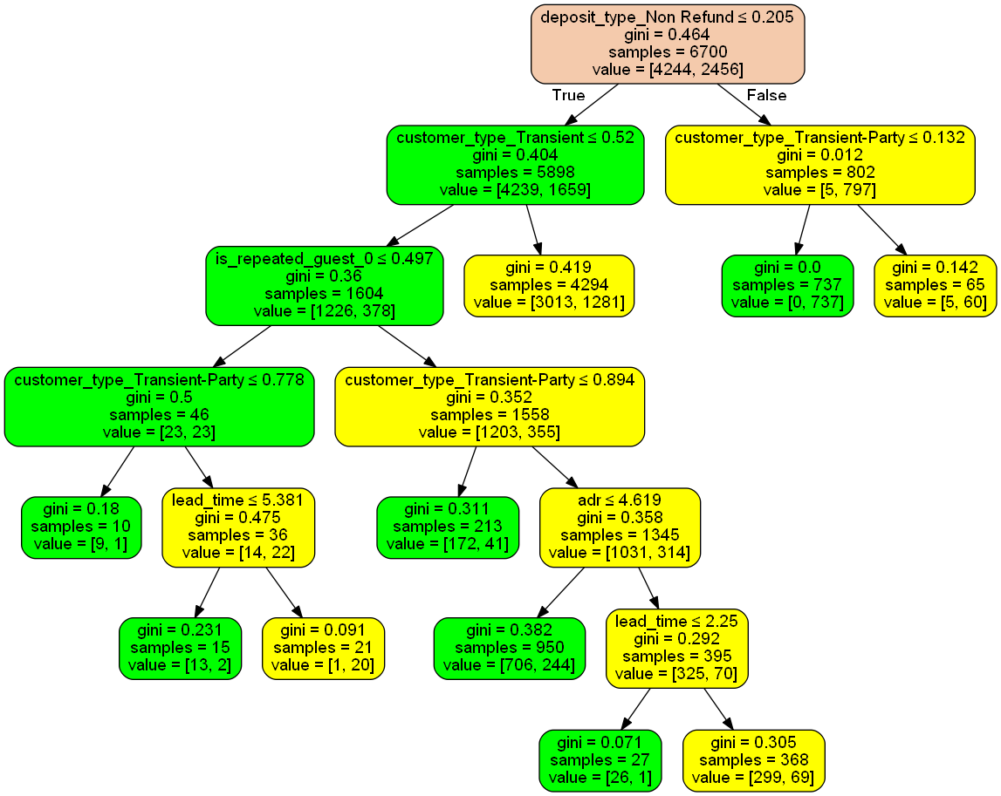
Model Inference

